Slide 1
Biomechanics of thorax
Dr.Abhishek Mishra
Dept. Of Cardiovascular & Respiratory Physiotherapy
MGM Institute Of Physiotherapy
Chh. Sambhajinagar

Slide 2
Contents
Introduction
Osteology
Articulation
Joint Kinetics
Joint Kinematics
Pathomechanics

Slide 3
Introduction
The Thorax consist of the Thoracic Vertebra the ribs and the sternum
Functions of thorax :
Base for muscle attachment of the upper extremity
Protection for the heart lungs and viscera
Ventilation

Slide 4
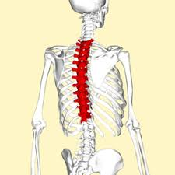
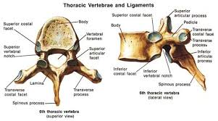
Structure
Thoracic Vertebra
There are 12 thoracic vertebra
Each coinciding with the 12 ribs

Slide 5
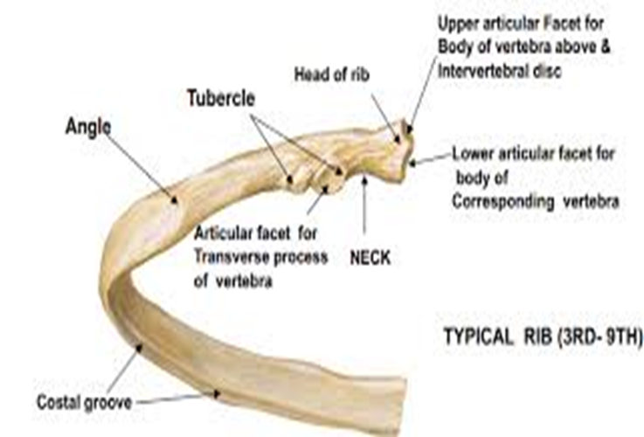
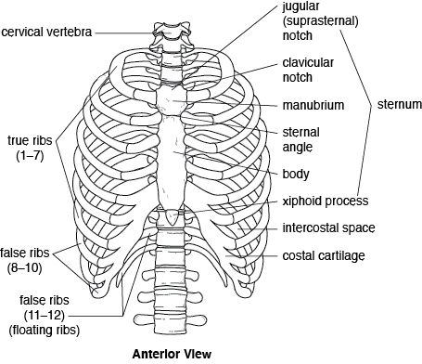
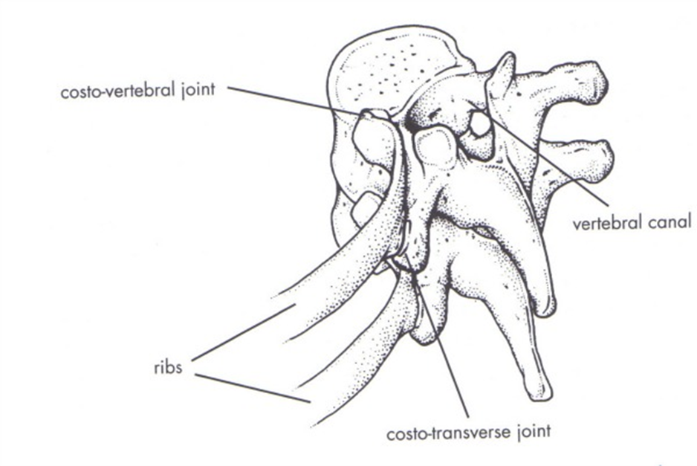
Ribs

Slide 6
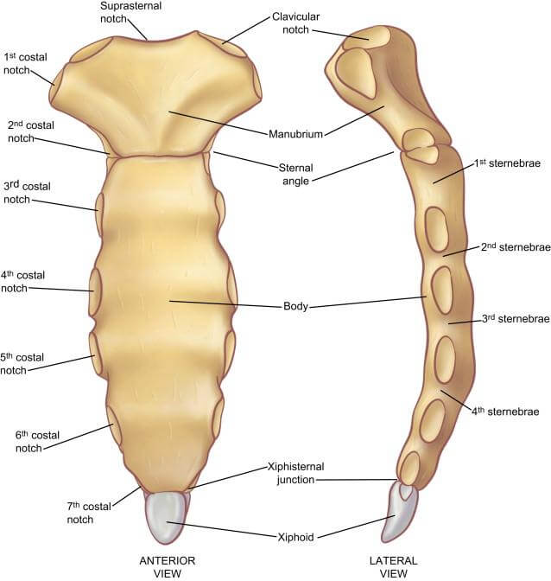
Sternum

Slide 7
Articulations of thorax

Slide 8
Joint | Type | Articulation | Ligament
1. Manubriosternal and Xiphisternal | Synchondrosis | Manubrium and body of sternum Sternal body and Xiphisternum | Fibrocartilaginous disk between hyaline cartilage
2. Costovertebral | Synovial joint | Head of the rib, adjacent vertebral body, and IV disk | Interosseus ligament Radiate ligament
3. costotransverse | Synovial joint | Costal tubercle of the rib with costal facet of transverse process | Lateral CT ligament Costotransverse ligament
4. Costochondral | Synchondrosis | 1st to 10th rib with costal cartilage antero-laterally | No ligamentous support
5. Chondrosternal | Synchondrosis | Costal cartilage of ribs 1 through 7 anteriorly with the sternum | Anterior and posterior radiate costosternal ligament Sternocostal ligament Costoxiphoid ligament

Slide 9
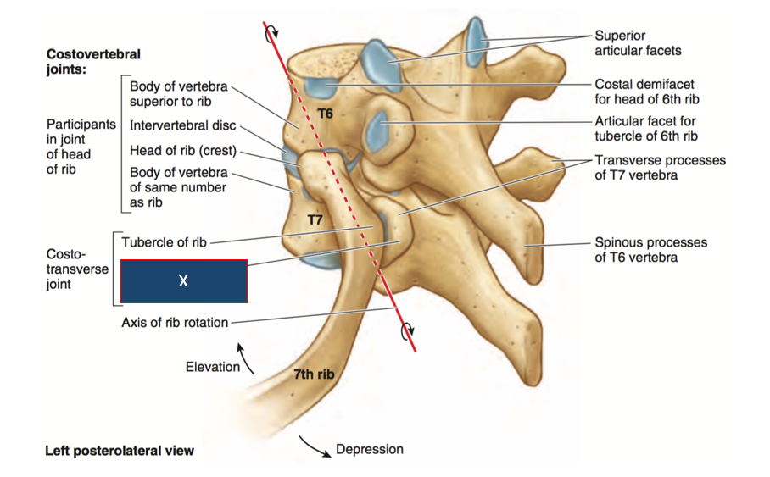

Slide 10
Joint Kinematics
The movement of the rib cage is an amazing combination of complex geometrics governed by
Types and angle of the articulations
The movement of the manubrium sternum
Elasticity of the costal cartilages
The length , shape and downward angle of each rib is unique and therefore the axes of rotation for the each rib is unique

Slide 11
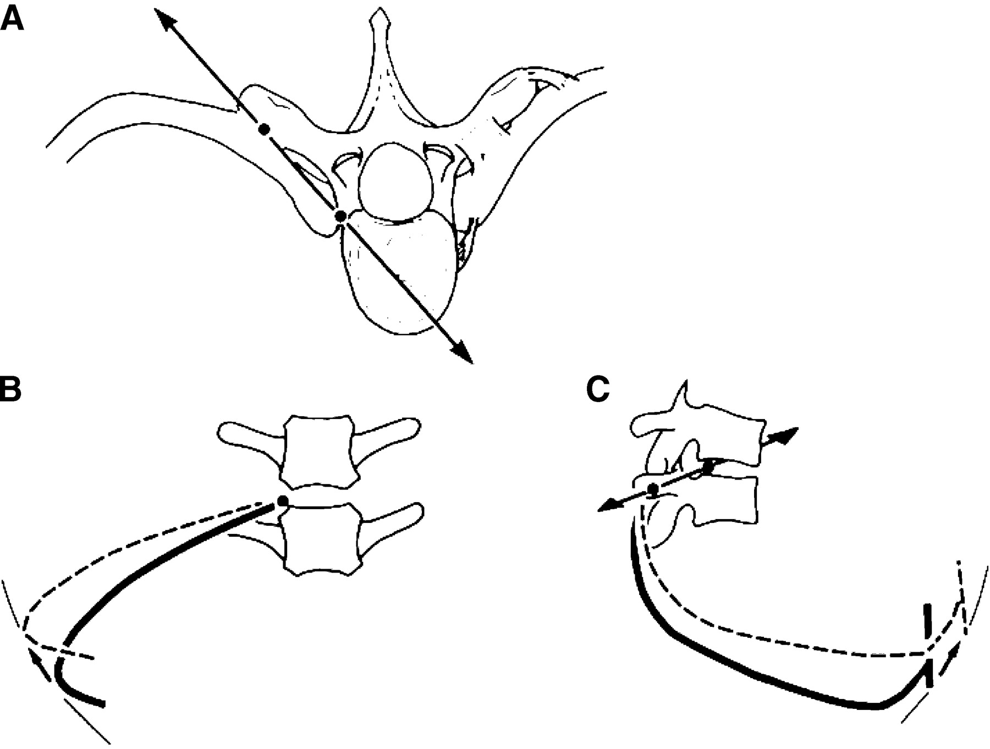
Movements at the costovertebral joints
The costovertebral joint and the costotransverse joint form a joint couple mechanically linked whose common movement can only be rotation about an axis passing through the centre of each joint
Direction of this axis with respect to the
sagittal axis determines the movements of
the Ribs

Slide 12
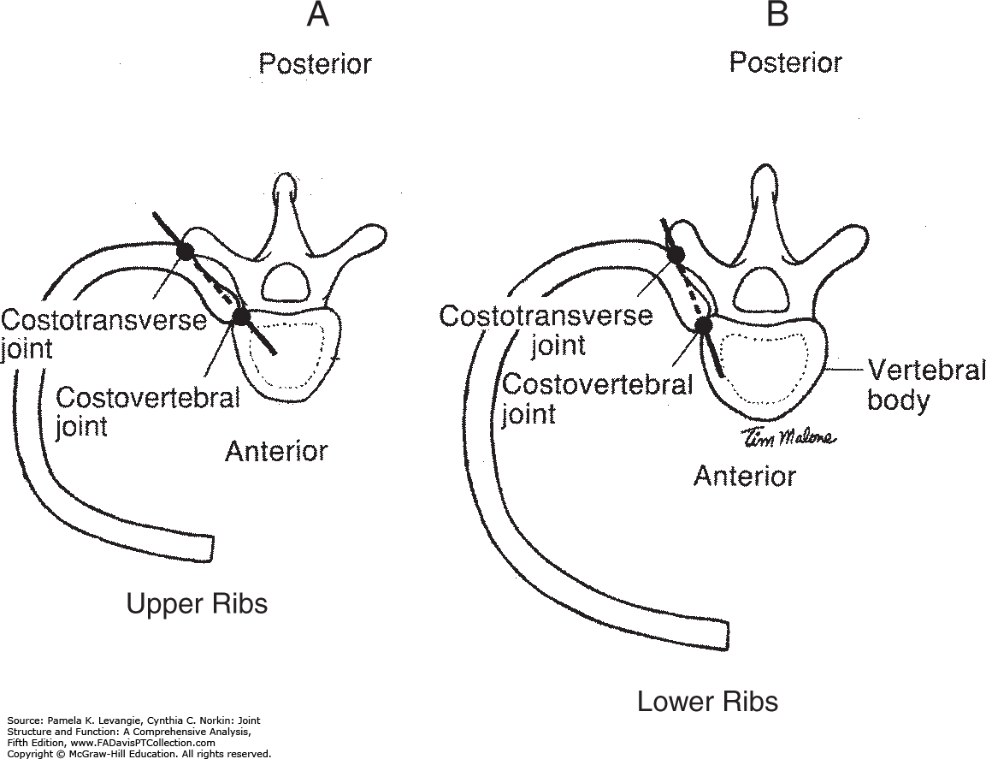

Slide 13
The Pump Handle Movement
This movement predominanty occurs in sagittal plane
Ribs 2 to 7 the upper ribs ; the movement occurs in the coronal axis at the vertebrae
The costal cartilage rotate upwards and becomes more horizontal with inspiration
The movement of the ribs pushes the sternum ventrally and superiorly
The manubrium doesn’t move thus causing increase in the movement of the body of the sternum in relation to the manubrium
This lead movement leads to an increase in the antero-posterior diameter of thorax

Slide 14
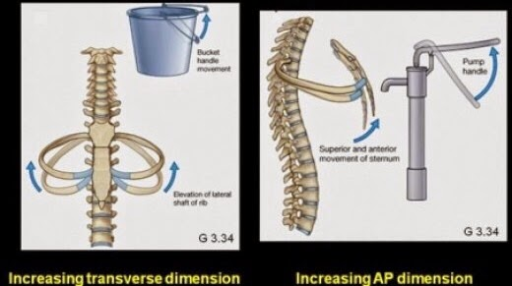

Slide 15
The bucket handle movement
The motion predominately occurs in the coronal plane
Elevation of ribs 8 to 10 occurs about a sagittal axis of motion
The lower ribs have more downward obliquity
The are indirectly attach to the sternum anteriorly
These factors allow the lower ribs motion at the lateral aspect of the rib cage
This causes increase in the transverse diameter of the lower thorax

Slide 17
Elasticity of costal cartilage
The costal cartilage display an angular displacement due to axial rotation
This rotation plays an important role during expiration
Considering the vertebral column fixed , during inspiration the sternum is raised, the costal cartilage rotate about their own axis

Slide 18
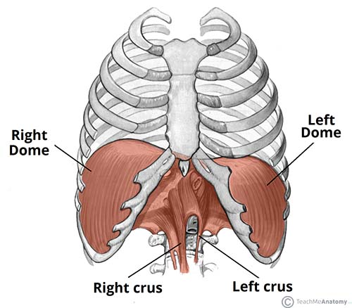
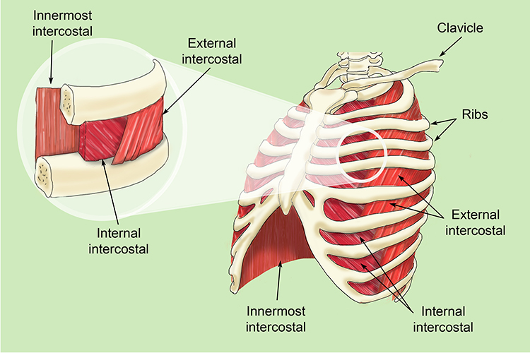
Muscles of Inspiration
Muscles of Expiration
Internal intercostal
Sternocostalis
Diaphragm
External intercostal Muscle

Slide 19
Difference between ventilatory and skeletal muscles:
They have increased fatigue resistance and greater oxidative capacity
They contract rhythmically throughout the life rather than episodically
They work primarily against the elastic properties of the lungs and airways resistance rather than against gravitational forces
Neurological control of these muscles both voluntary and involuntary
The actions of these muscles are life sustaining

Slide 20
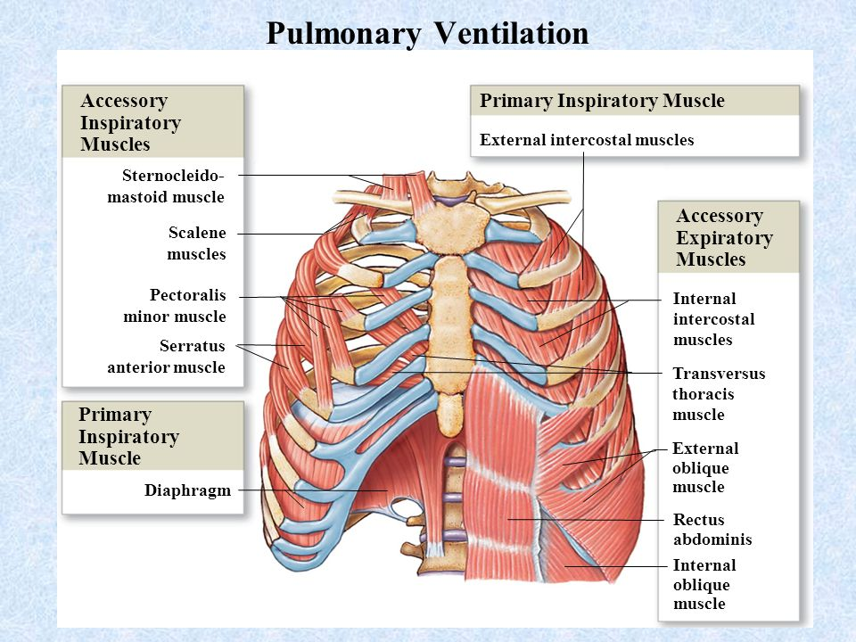

Slide 21
Diaphragm
Primary muscle of inspiration
Origin ; Insertion
Nerve supply
Development as a postural and respiratory muscle

Slide 22
Mode of action of Diaphragm
When the diaphragm contracts , the central tendon is pulled down thus increasing the vertical diameter of thorax
This depression is rapidly checked by the mediastinal constituents as they are stretched and the resistance offered by the abdominal organs
From this moment on , the central tendon is fixed and the muscle fibers are now acting at the periphery
These elevate the lower ribs contributing to an increase in the transverse diameter of the thorax
Simultaneously , with the help of the sternum it also elevates the upper ribs increasing the anterior-posterior diameter

Slide 23
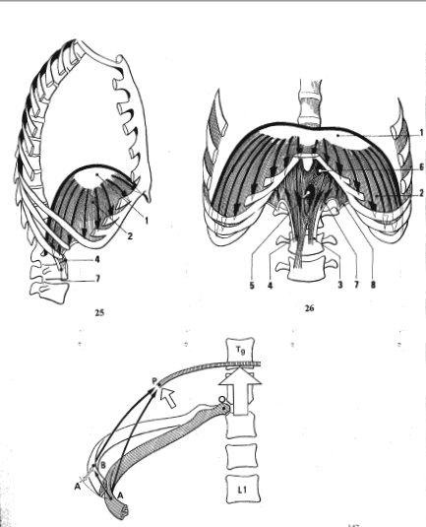

Slide 24
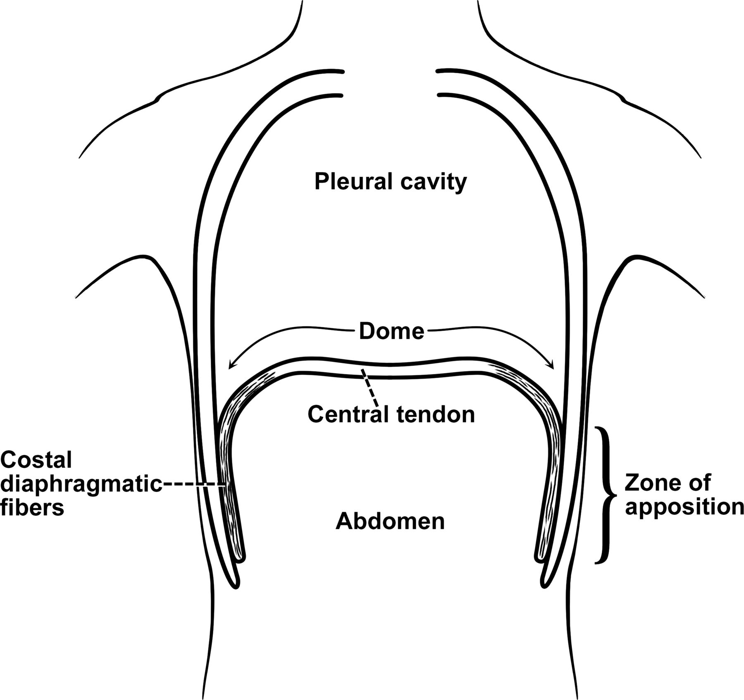
Zone of apposition
Its is area of diaphragm encompassing the cylindrical portion ( the part of the muscle shaped like a dome/umbrella)which corresponds to the portion directly apposed to the inner aspect of the lower rib cage

Slide 25
This ZOA is important because it is controlled by the abdominal muscles and directs the diaphragmatic action
The normal action of diaphragm is accompanied by a rotation of the ribs outwards ( external rotation) largely in part due to the ZOA
The normal force of pull on the sternal and the costal portions of the diaphragm would produce and internal rotation of the ribs
The ZOA creates an external rotation of these ribs primarily because the pressure of the thoracic cavity prevents an inward motion
when the ZOA is optimized the respiratory and postural roles of the diaphragm have maximal efficiency

Slide 26
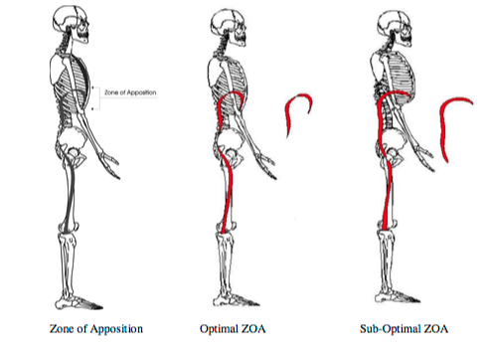
In suboptimal positions the diaphragm has a decreased ability to draw air into the thorax because of less caudal movement upon contraction and less effective tension of the diaphragm on the ribs
This decreased ZOA is accompanied by decreased expansion of the rib cage, postural alterations ,and compensatory increase in abdominal expansion

Slide 27
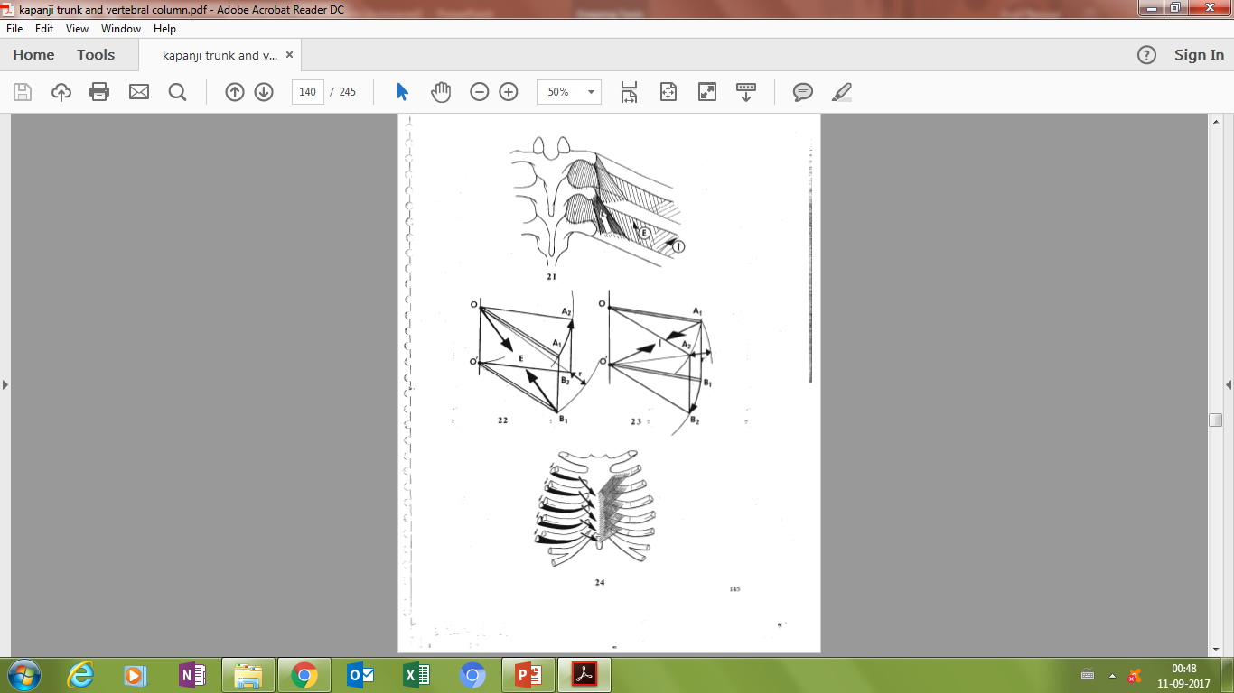
Mode of action of the external intercostal
The direction of fibers is parallel to the diagonal of the parallelogram OO’BA
when the muscle contracts (E) the diagonal is shortened
Thus distorting the parallelogram
Assuming OO’ is fixed
There is a rotation from A1 to A2 and B1 to B2 by a distance of r
Thus external intercostals elevate the ribs and it is a muscle of inspiration
O
A
E
O’
B

Slide 28
Mode of action on internal intercostal
The fibres are parallel to the short diagonal of parallelogram OO’AB
When the muscle (I) contracts the diagonal O’A shortens
The parallelogram is distorted and is displaced from A1 to A2 and B1 to B2 by a distance r
The internal intercostals depresses the ribs and is this active during forced expiration
A
O
I
O’
B

Slide 29
Synergism and antagonism of Diaphragm and abdominals
Both the set of muscle are always in active contraction but their activity varies reciprocally
During inspiration the tonus of the diaphragm increases
During expiration the tonus of the abdominals increases

Slide 30
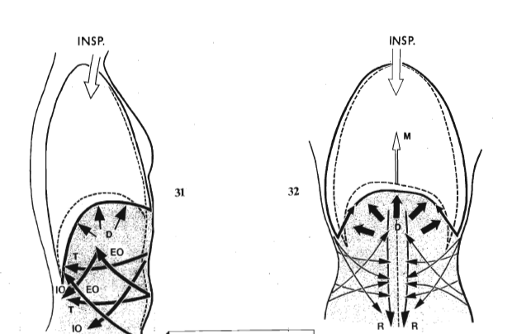
Diaphragm and abdominals during inspiration
The diaphragm contracts to increase the vertical diameter of the thorax
It is soon opposed by the resistance of the abdominal viscera
The abdominal muscles stabilise the central tendon and allow the diaphragm to elevate the lower ribs
This antagonistic synergistic action of the abdominals is therefore necessary for efficiency of diaphragm

Slide 31
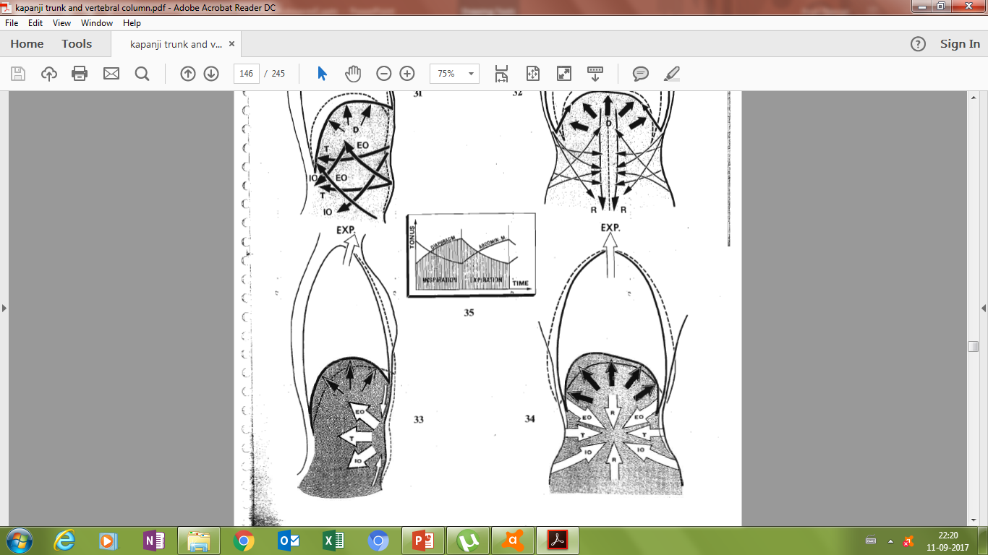
Diaphragm and abdominals during expiration
The diaphragm relax and contraction of the abdominal muscles lowers the thoracic floor
This decreases the transverse and anterior posterior diameter of the thorax
Also by increasing the intra abdominal pressure they push the viscera upwards and raise the central tendon
Abdominals act as the perfect agonist during expiration

Slide 32
Pathomechanics of thorax
COPD
Scoliosis

Slide 33
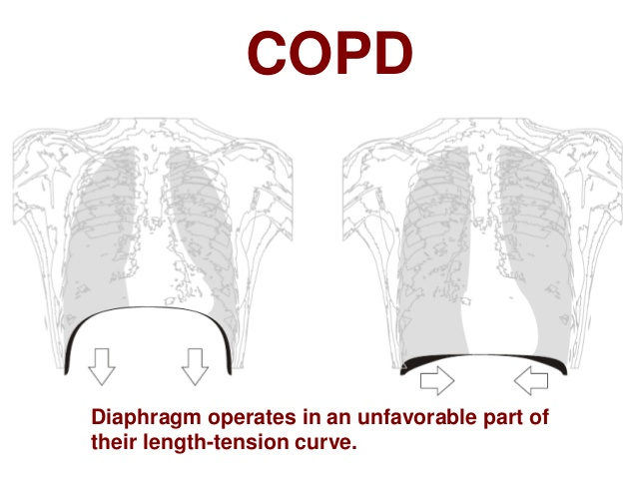
COPD
Chronic Obstructive Pulmonary Disease
Particular feature : Hyper inflation of the lungs
Descend and flattening of Diaphragm
Increased total Lung capacity
Reduced surface area of the whole diaphragm and reduction in surface area of its zone of apposition at FRC
Increase in antero-posterior diameter ;but the transverse diameter remains the same thus causing the rib cage to adopt a circular shape
Orientation of the fibers of the diaphragm changes

Slide 34
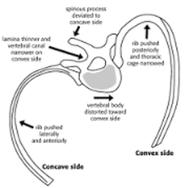
scoliosis
Increased lateral curvature of spine along with rotation of vertebrae
Lumbar and cervical curves cause minimal change in chest wall biomechanics but a thoracic curve causes restriction in ventilatory capacity – restriction proportional to severity of curve
Increased volume on concave side and decreased volume of convex side

Slide 35
Summary
Thorax and its function
Kinematics
Pump handle movement and bucket handle movement
Muscles of respirations and their kinetics
Diaphragm and abdominal muscles synergism and antagonism
Pathomechanics

Slide 36


